Slide 1
Smart Stethoscope for Pulmonary disease diagnosis
Guide - Dr. R Periyasamy Group:13
110117007- Aditya D
110117015- Arpit M
110117017- Asif Ahmed
110117023- B. Yasaswini
110117061- P Srikar
110117063- Pradnya R
110117069- Rishabh V

Slide 2
Objective and Implementation
The objective is to identify pulmonary ailments from lung sound recordings using Convolution Neural Networks.
The primary objective is to separate the heart noise from the over all corrupted signal,to import the audio files as spectrographs for the neural network to understand and classify.
The secondary objective lies to improve the network and make it more robust with minimal training data. To do this we have to find the best combinations of hidden layers, convolution layers and number of both input and output neurons.
Later we compare accuracies and confusion matrices of different models and report our findings.
IMPLEMENTATION
Localising and separating heart sounds from lung sounds.
Predicting the missing samples to reconstruct the overall lung signal.
Importing the audio files as spectrographs for neural networks.
Using Convolution Neural Network to classify different types of Lungs sound into varied categories.

Slide 3
METHODOLOGY- PHASE 1(Pre-processing)
Loading audio files, visualizing,, extracting frame info,framerate, duration.
Sampling,clipping, decomposing using Empirical Mode Decomposition
Obtaining Intrinsic Mode functions
Heart Sound Peak Detection and Localization
Estimate boundary(from peak location)
Generate Hilbert Envelope
Filtering with a butterworth filter(150Hz)
Locate peak
Smoothning envelope
Regenerating missed samples
Using predicitons
Combining denoised lung sounds with predicitons

Slide 4
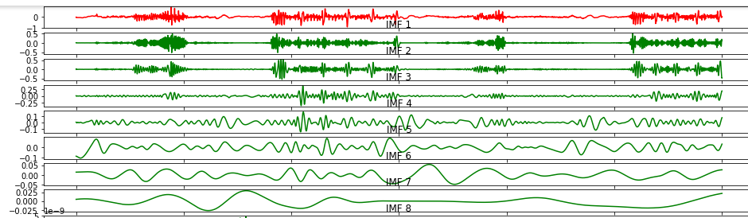
WORK DONE-EmpiricalModeDecomposition(Review1)
IMFs:

Slide 5
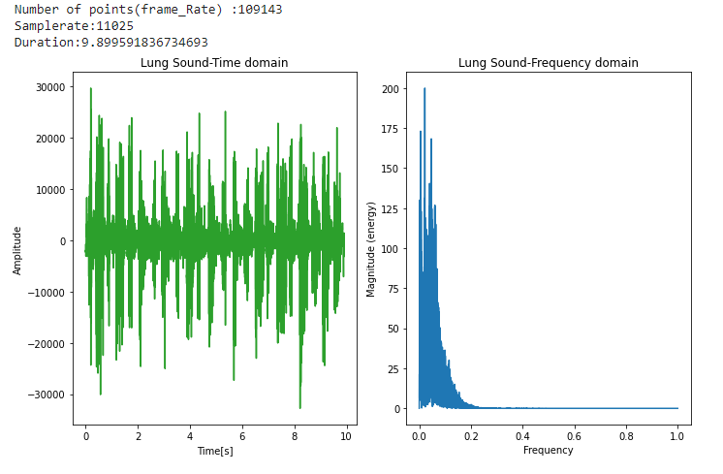
Signal in time and frequency domain

Slide 6
Filtering and Hilbert Envelope
Filtering using a butterworth filter of cutoff 150Hz(range of heart sounds).
Generating hilbert envelope to identify peaks and also locating minima which are useful for localizing the peak.
Smoothening the envelope further.
Using heron’s selection criteria - to ensure only heart peaks are noticed and not artifacts.
Only those peaks are retained in heron’s criteria where area under a peak is more than the variance of areas.

Slide 7
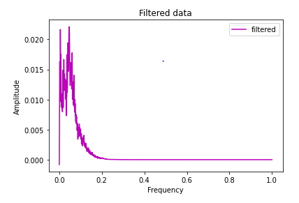
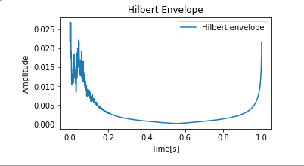
Filtering and Hilbert Envelope

Slide 8
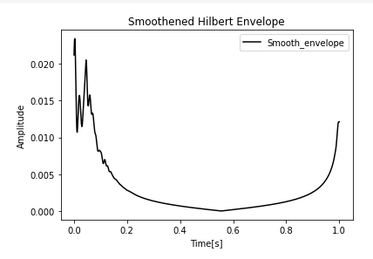
Smoothening

Slide 9
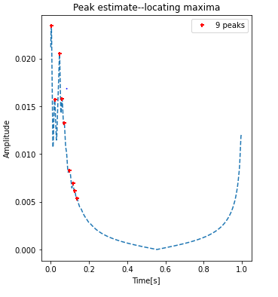
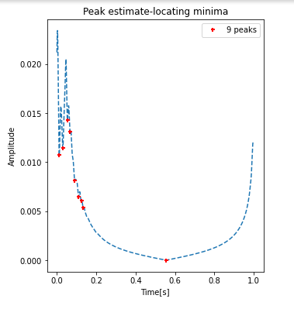
Peak detection - maxima and minima

Slide 10
WORK DONE
Pre-Processing
Visualizing the data to observe the cycles.
Obtaining the frequency spectrum.
Clipping the audio signal to the required duration and setting required number of sampling points.
Obtaining IMFs of the audio signal in time domain for further processing
Filtering data for identifying heart sound peak(located around 150Hz).
Obtaining hilbert envelope for the signal.
Processing the envelope and identifying peak values.

Slide 11
METHODOLOGY- PHASE 2(CNN)
Dataset collection and feature extraction.
Deciding on the number of layers and architecture.
Building the neural network and deciding number of filters in each convolution layer.
Constructing the ROC curve for each classes to understand whether our model is working properly or not
Training the network using different optimisers and loss functions
Deciding on the test-train split and checking the working of the model over different ratios.

Slide 12
Convolution Neural Network
A Convolutional Neural Network (ConvNet/CNN) is a Deep Learning algorithm which can take in an input image, assign importance (learnable weights and biases) to various aspects/objects in the image and be able to differentiate one from the other.
The architecture of a ConvNet is analogous to that of the connectivity pattern of Neurons in the Human Brain and was inspired by the organization of the Visual Cortex.
A ConvNet is able to successfully capture the Spatial and Temporal dependencies in an image through the application of relevant filters.
The role of the ConvNet is to reduce the images into a form which is easier to process, without losing features which are critical for getting a good prediction.

Slide 13
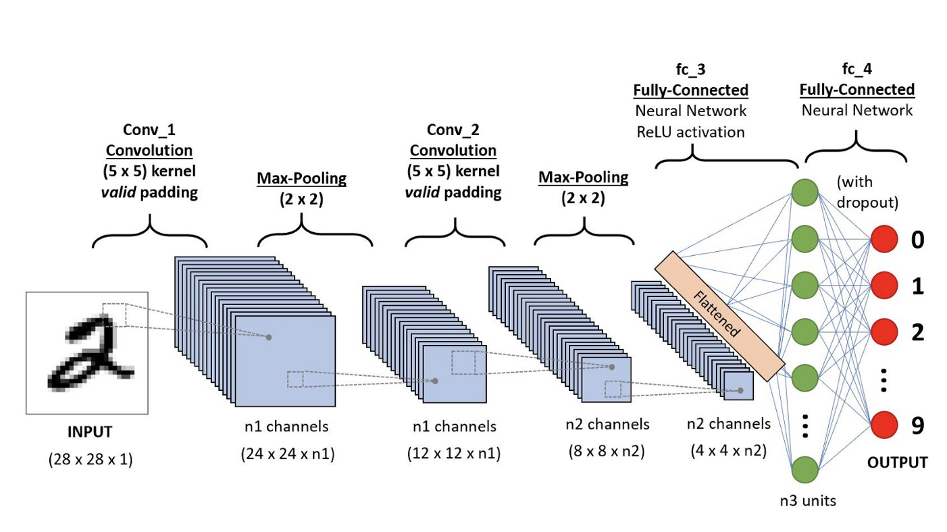
Diagrammatic representation Convolution Neural Network

Slide 14
WORK DONE
Lung Sound Classification using CNN
Splitted the dataset into two parts one of them is training dataset and other is test dataset.
Built the neural network with three convolution layers and one dense layer.
Trained the CNN model that we have designed with dataset and also reviewed the accuracy.
Plot the ROC( Receiver operating characteristic curve) for each classes to check whether our model is just making random prediction or it’s predictions are actually correct.This is done by checking the AUC(area under curve) for each classes.

Slide 15
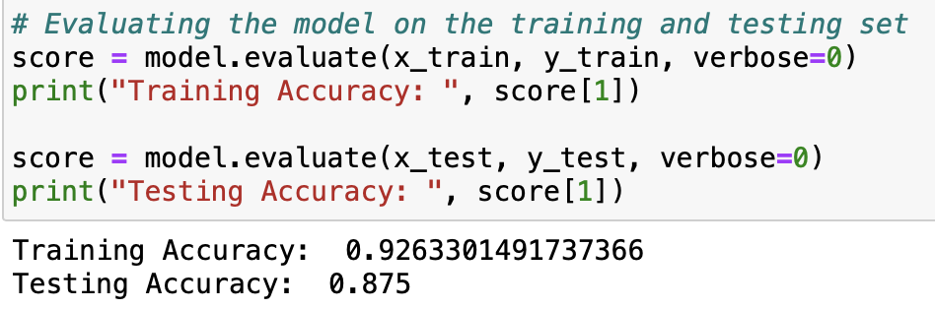
Results after training
The system after 250 epochs was able to achieve an accuracy of 87.5% on the testing data. The accuracy over training data was 92.63%

Slide 16
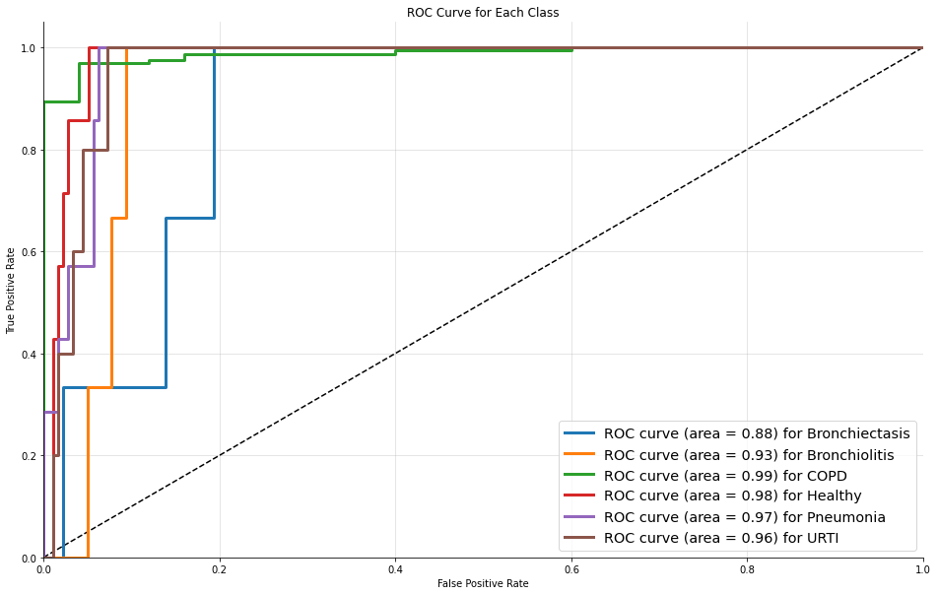
ROC Curve

Slide 17
AUC-ROC Curve
AUC- ROC curve is a performance measurement for the classification problems at various threshold settings. ROC is a probability curve and AUC represents the degree or measure of separability.
Higher the AUC, the better the model is at predicting 0s as 0s and 1s as 1s.
By analogy, the Higher the AUC, the better the model is at distinguishing between patients with the disease and no disease.
An excellent model has AUC near to the 1 which means it has a good measure of separability. A poor model has AUC near to the 0 which means it has the worst measure of separability.

Slide 18
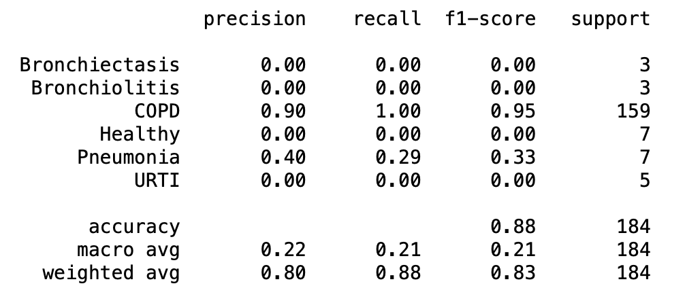
System metrics
Precision is the ratio between the True Positives and all the Positives.
The recall is the measure of our model correctly identifying True Positives.
F1-score is the Harmonic mean of the Precision and Recall
For our system, we got the following metrics.

Slide 19
Confusion Matrix
It is the easiest way to measure the performance of a classification problem where the output can be of two or more type of classes. A confusion matrix is a table with two dimensions viz. “Actual” and “Predicted” and furthermore, both the dimensions have “True Positives (TP)”, “True Negatives (TN)”, “False Positives (FP)”, “False Negatives (FN)”.

Slide 20
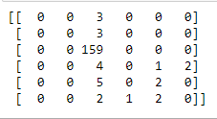
Confusion Matrix
Predicted
Actual
Bronchiectasis
Bronchiolitis
COPD
Healthy
Pneumonia
URTI
Bronchiectasis
Bronchiolitis
COPD
Healthy
Pneumonia
URTI

Slide 21
WORK TO BE DONE
Lung Sound Enhancement
Removing localized peaks from each IMF
Generating missing samples in the lung sound using prediction algorithms.
Combining the denoised and regenerated samples to generate enhanced lung sound.

Slide 22
WORK TO BE DONE
Lung Sound Classification using CNN
Experimenting with the model to improve accuracy by changing various parameters.
Trying to see the effects of changes in number of layers and number of epochs on the model accuracy.
Trying to test the model accuracy on data outside the dataset used for training and testing if possible.

Slide 23
THANK YOU

